Slide 1
Math 769: Statistical Learning

Slide 2
k-Fold Cross Validation
Shahrzad Jamshidi, PhD

Slide 3
Last Time
We defined VC dimension, a method of evaluating model complexity.
The VC dimension can be used to estimate prediction error using only the training error.
This is useful when working with datasets too small to allow for a testing set.

Slide 4
Objectives
Define k-fold cross validation.
Compute an estimate for the expected prediction error using k-fold cross validation.
Discuss some considerations for picking the number of folds.

Slide 5
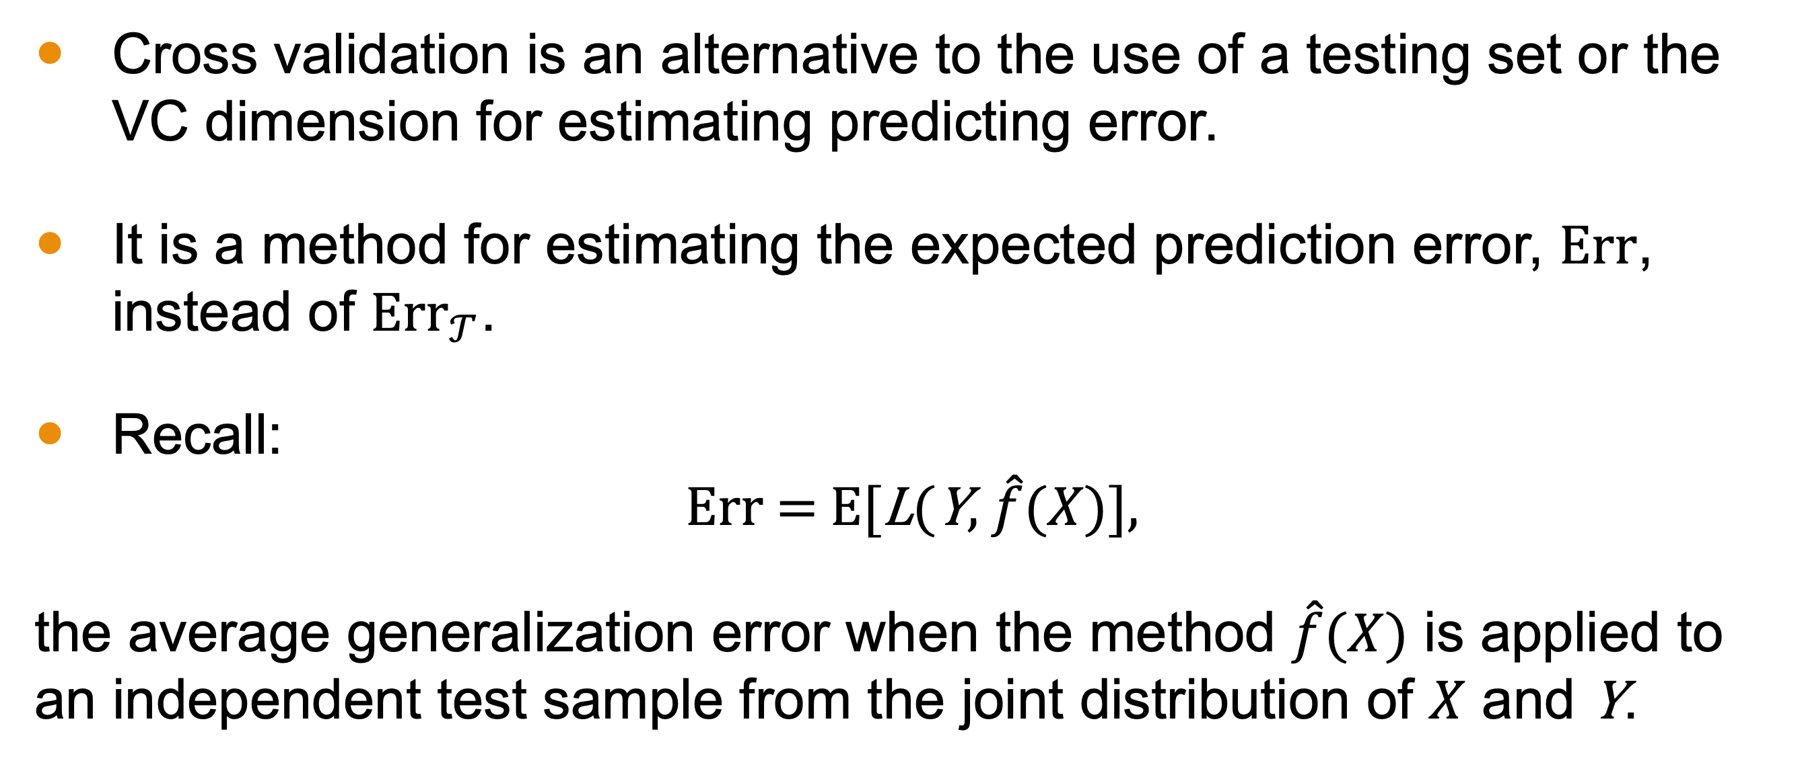
Purpose of Cross Validation
Cross validation is an alternative to the use of a testing set or the VC dimension for estimating predicting error.
It is a method for estimating the expected prediction error, $\text{Err}$, instead of ${\text{Err}}_{𝒯}$.
Recall:
$$\text{Err}\text{ = }\text{E}\text{[}\text{L}\text{(}\text{Y}\text{, }\hat{f}(X)\text{],}$$
the average generalization error when the method $\hat{f}(X)$ is applied to an independent test sample from the joint distribution of $X$ and $\text{Y}$.

Slide 6
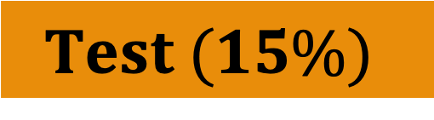

k-Fold Cross Validation Setup
Ideally, a dataset is large enough to allow for a testing set, where some proportion of samples are set aside for evaluation of the final model.
If the dataset is too small to allow this, k-fold cross validation involves randomly breaking up the dataset into k roughly equa-sized “folds”
$$\text{Training}\text{ (85\%)}$$
$$Test (15\%)$$
Fold 1
Fold 2
Fold 3
Fold 4
Fold 5
Fold 6

Slide 7
Computing k-Fold Cross Validation
Idea: We do k iterations where treat each fold like a testing set.
For example, for the 3rd iteration, we
use folds 1, 2, 4, 5, and 6 as a training set
fit the model to the training set
compute the loss of the model using fold 3 (like a testing set)
store the results of the evaluation
Fold 1
Fold 2
Fold 3
Fold 4
Fold 5
Fold 6

Slide 8
Iterations
Losses are found for each possible hold out.
Fold 1
Fold 2
Fold 3
Fold 4
Fold 5
Fold 6
Fold 1
Fold 2
Fold 3
Fold 4
Fold 5
Fold 6
Fold 1
Fold 2
Fold 3
Fold 4
Fold 5
Fold 6
Fold 1
Fold 2
Fold 3
Fold 4
Fold 5
Fold 6
Fold 1
Fold 2
Fold 3
Fold 4
Fold 5
Fold 6
Fold 1
Fold 2
Fold 3
Fold 4
Fold 5
Fold 6

Slide 9
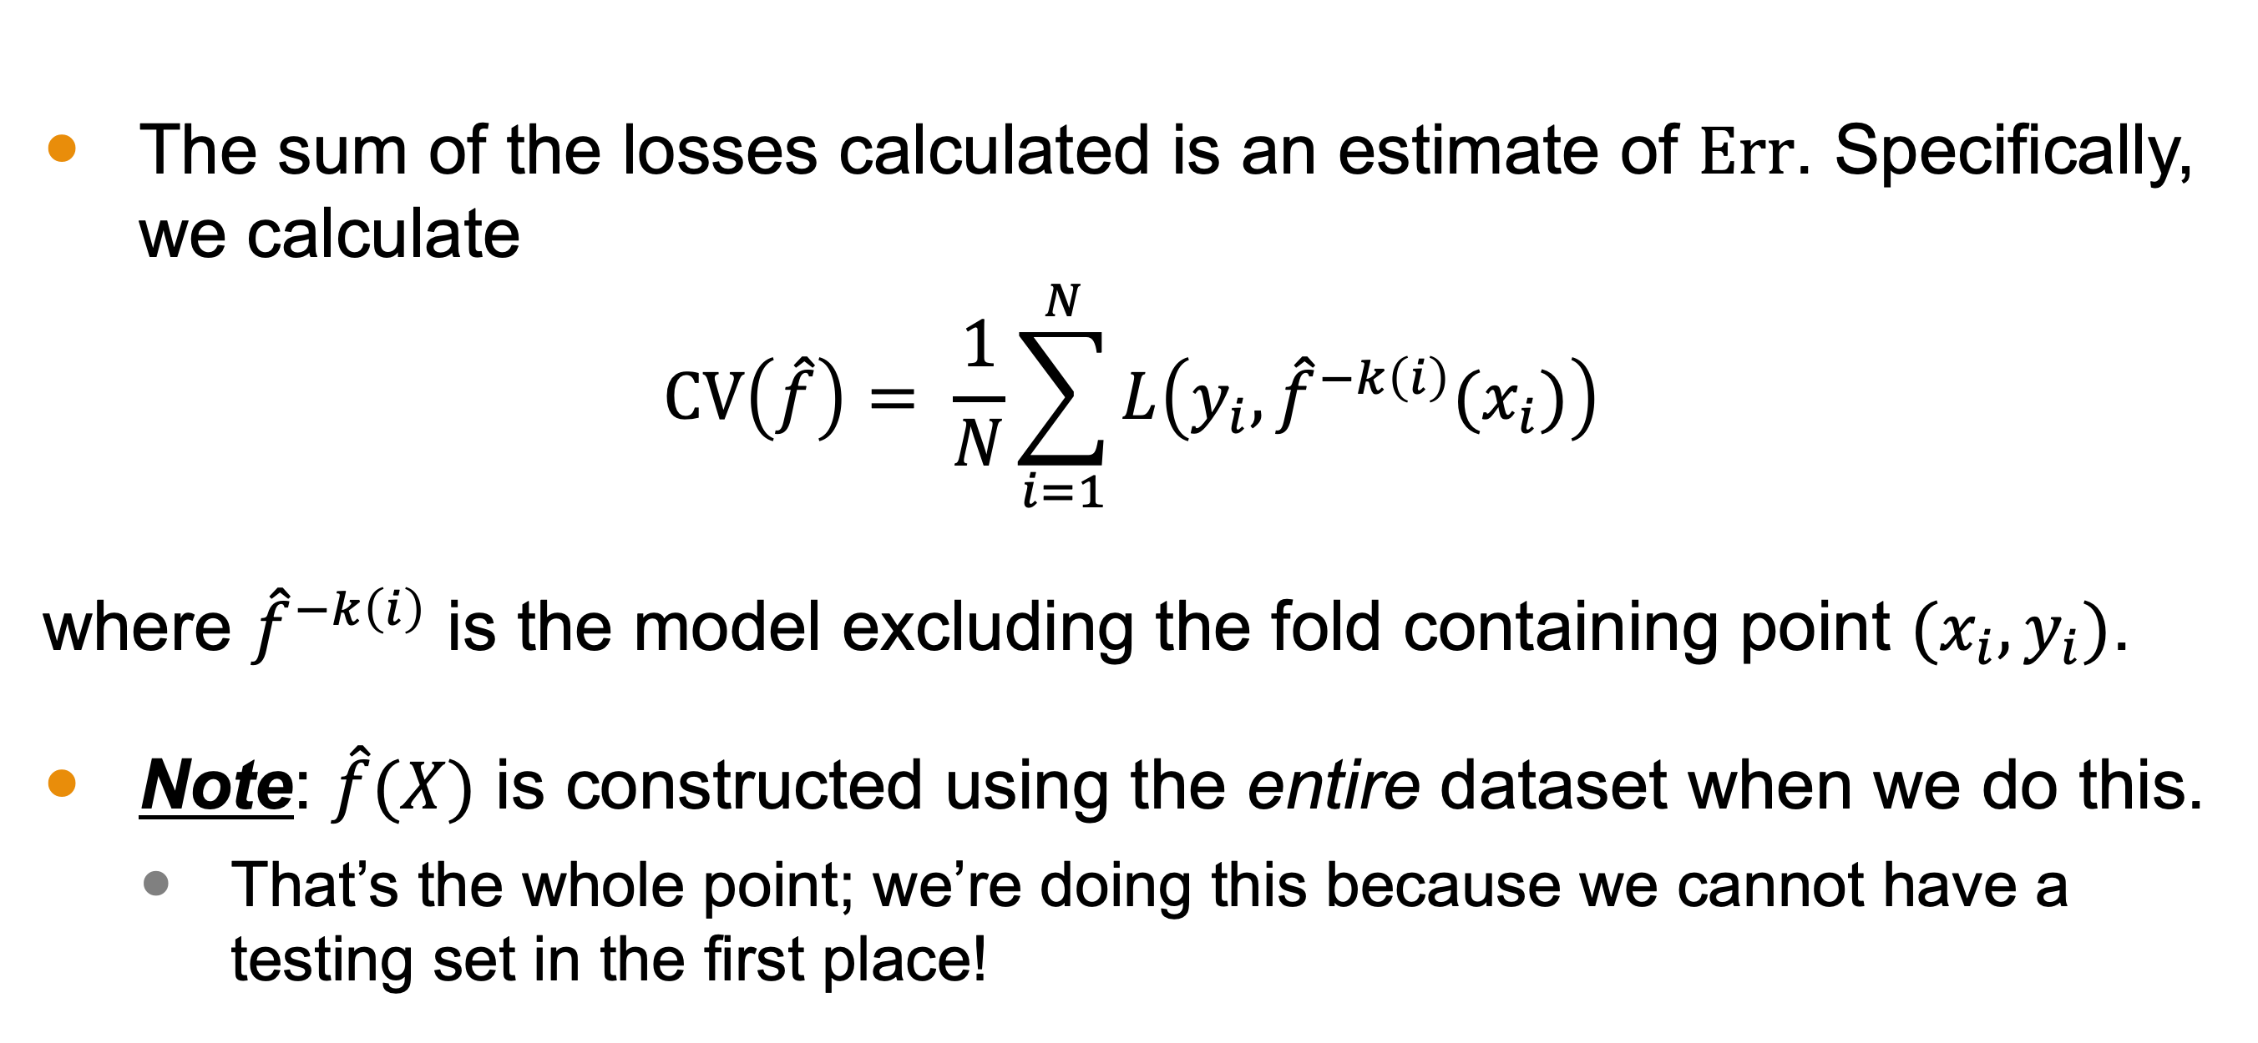
Tabulating Results
The sum of the losses calculated is an estimate of $\text{Err}$. Specifically, we calculate
$$CV\left(\hat{f}\right)= \frac{1}{N}\sum_{i=1}^{N}{L\left(y_{i}, {\hat{f}}^{−k\left(i\right)}(x_{i})\right)}$$
where ${\hat{f}}^{−k\left(i\right)}$ is the model excluding the fold containing point $(x_{i},y_{i})$.
Note: $\hat{f}(X)$ is constructed using the entire dataset when we do this.
That’s the whole point; we’re doing this because we cannot have a testing set in the first place!

Slide 10
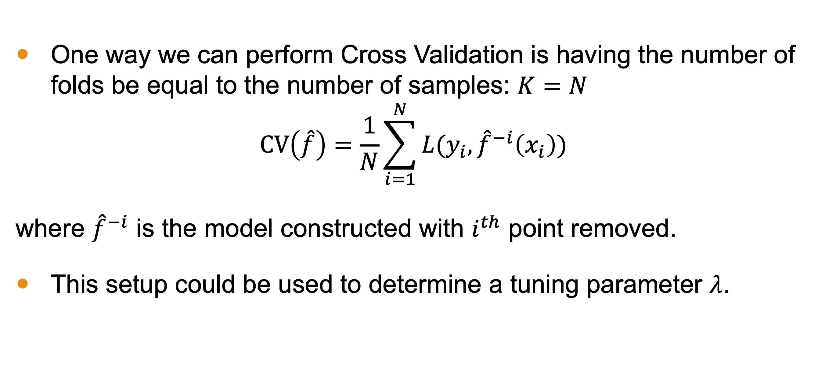
Leave-one-out Cross Validation
One way we can perform Cross Validation is having the number of folds be equal to the number of samples: $K=N$
$$CV\left(\hat{f}\right)=\frac{1}{N}\sum_{i=1}^{N}{L(y_{i}, {\hat{f}}^{−i}\left(x_{i}\right))}$$
where ${\hat{f}}^{−i}$ is the model constructed with $i^{th}$ point removed.
This setup could be used to determine a tuning parameter $λ$.

Slide 11
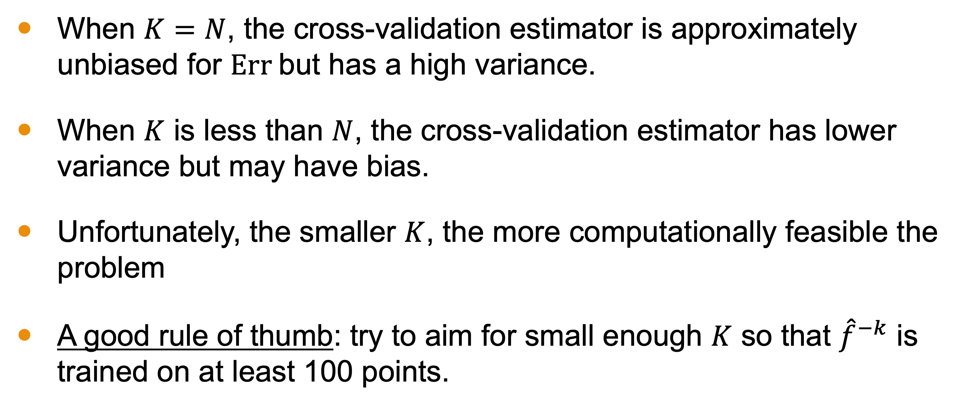
What Value of K to Pick?
When $K=N$, the cross-validation estimator is approximately unbiased for $\text{Err}$but has a high variance.
When $K$ is less than $N$, the cross-validation estimator has lower variance but may have bias.
Unfortunately, the smaller $K$, the more computationally feasible the problem
A good rule of thumb: try to aim for small enough $K$ so that ${\hat{f}}^{−k}$ is trained on at least 100 points.

Slide 12
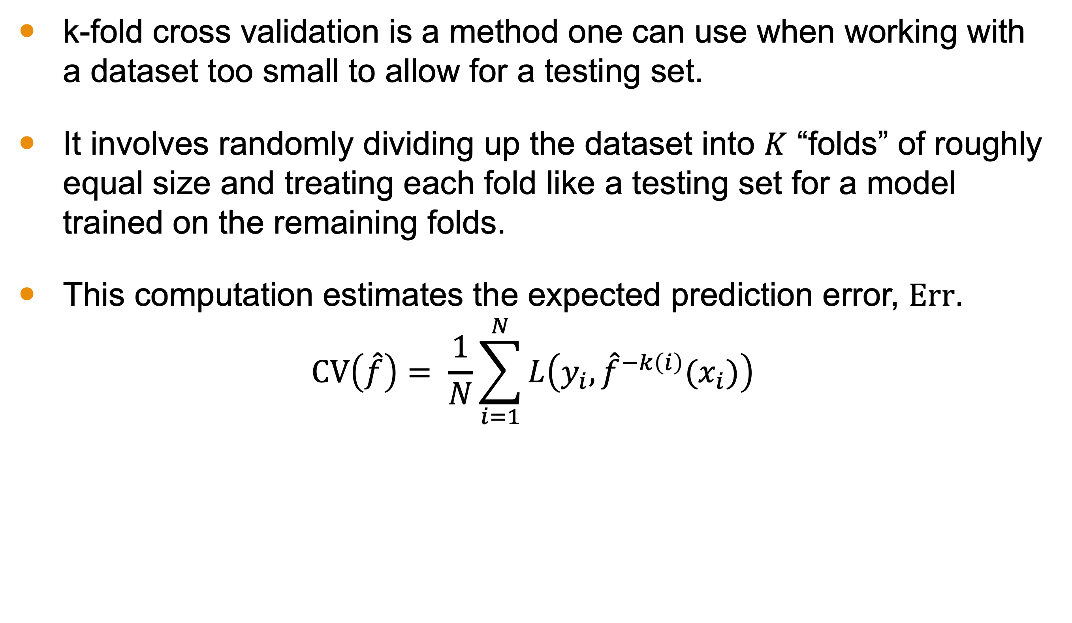
Conclusion
k-fold cross validation is a method one can use when working with a dataset too small to allow for a testing set.
It involves randomly dividing up the dataset into $K$ “folds” of roughly equal size and treating each fold like a testing set for a model trained on the remaining folds.
This computation estimates the expected prediction error, $\text{Err}$.
$$CV\left(\hat{f}\right)= \frac{1}{N}\sum_{i=1}^{N}{L\left(y_{i}, {\hat{f}}^{−k\left(i\right)}(x_{i})\right)}$$

Slide 13
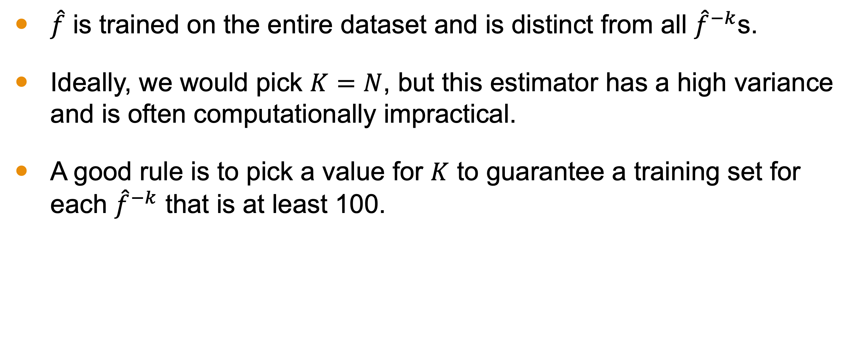
Conclusion
$\hat{f}$ is trained on the entire dataset and is distinct from all ${\hat{f}}^{−k}$s.
Ideally, we would pick $K=N$, but this estimator has a high variance and is often computationally impractical.
A good rule is to pick a value for $K$ to guarantee a training set for each ${\hat{f}}^{−k}$ that is at least 100.

